Slide 1
Radio Frequency Components, Measurements & Mathematics
Chapter 03

Slide 2
What Will I Learn?
We will cover six key areas of RF communications:
RF components
RF measurements
RF mathematics
RSSI thresholds
Link budgets
Fade margins

Slide 3
What Will I Learn?
It is important to understand how each of the RF components affects the output of the transceiver.
Whenever a component is added, removed, or modified, the output of the RF communications is changed.
You need to understand these changes and make sure that the system conforms to regulatory standards.
The following RF components were key in this lesson:
Transmitter
Receiver
Antenna
Isotropic radiator
Intentional radiator (IR)
Equivalent isotropically radiated power (EIRP)

Slide 4
What Will I Learn?
In addition to understanding the components and their effects on the transmitted signal, you must know the different units of power and comparison that are used to measure the output and the changes to the RF communications:
Units of power
Watt
Milliwatt
dBm
Units of comparison
dB
dBi
dBd

Slide 5
What Will I Learn?
After you become familiar with the RF components and their effects on RF communications, and you know the different units of power and comparison, you need to understand how to perform the actual calculations and determine whether your RF communication will be successful.
It is important to know how to perform the calculations and some of the terms and concepts involved with making sure that the RF link will work properly.
These concepts and terms are as follows:
Rule of 10s and 3s
Receive sensitivity
Received signal strength indicator (RSSI)
Link budget
System operating margin (SOM)/fade margin

Slide 6
Key Terms
6 dB rule
antenna
bel
dBm
decibel (dB)
decibels dipole (dBd)
decibels isotropic (dBi)
dynamic rate switching(DRS)
equivalent isotropically radiated power (EIRP)
fade margin
insertion loss
intentional radiator (IR)
inverse square law
isotropic radiator
link budget
milliwatt (mW)
point source
receive sensitivity
received signal strength indicator (RSSI)
receiver
roaming
rule of 10s and 3s
signal quality (SQ)
signal-to-noise ratio (SNR)
system operating margin (SOM)
transceiver
transmitter
watt (W)

Slide 7
Key Topics
3.1. RF Components
3.2. Units of Power and Comparison
3.3. RF Mathematics

Slide 8
Discussion Topics
Components of RF communications
Transmitter
Receiver
Antenna
Isotropic radiator
Intentional radiator (IR)
Equivalent isotropically radiated power (EIRP)
Units of power and comparison
Watt
Milliwatt
Decibel (dB)
dBi
dBd
dBm
Inverse square law
RF mathematics
Rule of 10s and 3s
Received signal strength indicator (RSSI)
Link budget
Fade margin/system operating margin

Slide 9
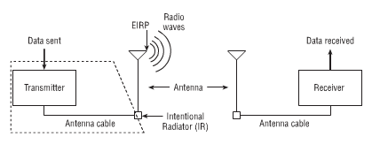
RF Components

Slide 10
Transmitter
The transmitter is the initial component in the creation of the wireless medium.
The computer hands the data off to the transmitter, and it is the transmitter’s job is to begin the RF communication.
The transmitter takes the data provided and modifies the AC signal by using a modulation technique to encode the data into the signal.
This modulated AC signal is now a carrier signal, containing the data to be transmitted.
The carrier signal is then transported either directly to the antenna or through a cable to the antenna.
In addition to generating a signal at a specific frequency, the transmitter is responsible for determining the original transmission amplitude (power level) of the transmitter.

Slide 11
Antenna
An antenna provides two functions in a communication system.
When connected to the transmitter, it collects the AC signal that it receives from the transmitter and directs, or radiates, the RF waves away from the antenna in a pattern specific to the antenna type.
When connected to the receiver, the antenna takes the RF waves that it receives through the air and directs the AC signal to the receiver. The receiver converts the AC signal to bits and bytes.
The signal of an antenna is usually compared or referenced to an isotropic radiator.
An Isotropic radiator is a point source that radiates signal equally in all directions.
There are two ways to increase the power output from an antenna.
The first is to generate more power at the transmitter, as stated in the previous section.
The other is to direct, or focus, the RF signal that is radiating from the antenna.

Slide 12
Receiver
The receiver is the final component in the wireless medium.
The receiver takes the carrier signal that is received from the antenna and translates the modulated signals into 1s and 0s.
It then takes this data and passes it to the computer to be processed.
The job of the receiver is not always an easy.
The signal that is received is a much less powerful signal than what was transmitted due to:
the distance it has traveled and
the effects of free space path loss (FSPL)
interference from other RF sources and multipath

Slide 13
Intentional Radiator (IR)
The FCC Code of Federal Regulations (CFR) Part 15 defines an intentional radiator (IR)
is a device that intentionally generates and emits radio frequency energy by:
radiation or
induction.
Basically, IR is specifically designed to generate RF as opposed to something that generates RF as a by-product of its main function, such as a motorcycle engine that incidentally generates RF noise.
The power output of the IR is the sum of all the components from the transmitter to the antenna, but not including the antenna.
The power of the IR is measured at the connecter that provides input to the antenna
This power level is typically measured in milliwatts (mW) or decibels relative to 1 milliwatt (dBm)

Slide 14
Equivalent Isotropically Radiated Power (EIRP)
EIRP is the highest RF signal strength that is transmitted from a particular antenna
Antennas are capable of focusing, or directing RF energy
This focusing capability can make the effective output of the antenna much greater than the signal entering the antenna. Because of this ability to amplify the output of the RF signal, regulatory bodies such as the FCC limit the amount of EIRP from an antenna.
Later you will learn how to calculate how much power is actually being provided to the antenna (IR) and how much power is coming out of the antenna (EIRP)
You will need to know the definitions of IR and EIRP measurements.
However, the CWNA exam (PW0-104) will not test you on any power regulations

Slide 15
Units of Power and Comparison
When a wireless network is designed, two key components are:
coverage and
performance.
A good understanding of RF power, comparison, and RF mathematics can be very helpful during the network design phase.
Comparative units of measurement are useful when working with units of power.
We can use comparative units of power to compare the area that one access point can cover vs. another access point.
Using simple mathematics, we can determine things such as how many watts are needed to double the distance of a signal from an access point.
Units of power are used to measure transmission amplitude and received amplitude.
Units of power measurements are absolute power measurements.
Units of comparison are often used to:
measure how much gain or loss occurs because of the introduction of cabling or an antenna
represent a difference in power from point A to point B
measure change in power

Slide 16
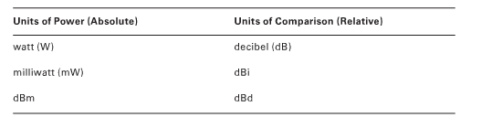
Units of Measure

Slide 17
Watt
A watt (W) is the basic unit of power, named after James Watt, an 18th-century Scottish inventor.
One watt is equal to 1 ampere (amp) of current flowing at 1 volt.
Power washer analogy - The success of a power washer is based on two components:
the pressure applied to the water, and
the volume (flow) of water used over a period of time
A watt is very similar to the output of the power washer.
Instead of the pressure generated by the machine, electrical systems have voltage.
Instead of water flow, electrical systems have current, which is measured in amps.
So the amount of watts generated is equal to the volts times the amps.
W = v*a

Slide 18
Milliwatt (mW)
A milliwatt (mW) is also a unit of power.
A milliwatt is 1/1,000 of a watt.
The reason you need to be concerned with milliwatts is because most of the 802.11 equipment that you will be using transmits at power levels between 1 mW and 100 mW
Even though the FCC allows IR output as much as 1W, rarely in point-to-point communications, such as in building-to-building bridge links, would you use 802.11 equipment with more than 250 mW of transmit power

Slide 19
Decibel (dB)
A decibel (dB) is a unit of comparison, not a unit of power
Therefore, it is used to represent a difference between two values
A dB is a relative expression and a measurement of change in power
dB is used to represent the difference or loss between the EIRP output of a transmitter’s
antenna and the amount of power received by the receiver’s antenna
So in and of itself dB is not a measure of power but a measure of comparison
Decibel is derived from the term bel. Bell Telephone Laboratories needed a way to represent power losses on telephone lines as power ratios. They defined a bel as the ratio of 10 to 1 between the power of two sounds.

Slide 20
Decibel (dB)
Let’s look at an example:
An access point transmits data at 100 mW.
Laptop1 receives the signal at a power level of 10 mW,
Laptop2 receives the signal at a power level of 1 mW.
The difference between the signal from the access point (100 mW) to laptop1 (10 mW) is 100:10, or a 10:1 ratio, or 1 bel.
The difference between the signal from Laptop1 (10 mW) to laptop2 (1 mW) is 10:1, also a 10:1 ratio, or 1 bel.
Therefore the power difference between the access point and laptop2 is 2 bels.

Slide 21
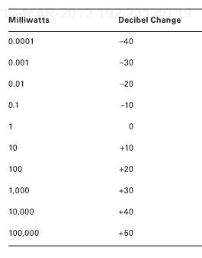
Milliwatt & Decibel Change (Relative to 1 mW)

Slide 22
Logarithms
Bels can be looked at mathematically by using logarithms.
First, we need to look at raising a number to a power.
If you take 10 and raise it to the third power (10³ = y), what you are actually doing is multiplying three 10s (10 × 10 × 10).
If you do the math, you will calculate that y is equal to 1,000.
So the solution is 10³ = 1,000.
When calculating logarithms, you change the formula to 10y = 1,000.
Here you are trying to figure out what power 10 needs to be raised to in order to get to 1,000.
You know in this example that the answer is 3.

Slide 23
Logarithms
You can also write this equation as y = log₁₀ (1,000) or y = log₁₀ 1,000. So the complete equation is 3 = log₁₀ (1,000).
10¹ = 10 log₁₀ (10) = 1
10² = 100 log₁₀ (100) = 2
10³ = 1,000 log₁₀ (1,000) = 3
10⁴ = 10,000 log₁₀ (10,000) = 4
Let’ calculate the bels from the access point to the laptop2 example by using logarithms.
Bels are used to calculate the ratio between two powers.
So let’s refer to the power of the access point as P_{AP} and the power of laptop1 as P_{L1}.
So the formula for this example would be y = log₁₀ (P_{AP}/P_{L1}).
If you plug in the power values, the formula becomes y = log₁₀ (100/1), or y = log₁₀(100).
So this equation is asking, 10 raised to what power equals 100?
The answer is 2 bels (10² = 100) --- this answer is in bels how about decibels?

Slide 24
Logarithms
To calculate decibels, all you need to do is multiply bels by 10
So the formulas for bels and decibels are as follows:
bels = log₁₀ (P₁/P₂)
decibels = 10 × log₁₀ (P₁/P₂)
That works for P_{L1} (laptop 1)
Now for P_{L2} (laptop 2)
The formula now is y = 10 × log₁₀ (P_{AP}/P_{L1}).
If you plug in the power values, the formula becomes
y = 10 × log₁₀ (100/1), or
y = 10 × log₁₀ (100)
So the answer is +20 decibels.

Slide 25
Logarithms
Why should you use Decibels which are a relative comparison to mW?
If an access point is transmitting at 100 mW, and a laptop is 100 meters (0.1 kilometer)
away from the access point, the laptop is receiving only about 0.000001 milliwatts of
power.
The difference between the numbers 100 and 0.000001 is so large that it doesn’t have much relevance to someone looking at it.
Additionally, it would be easy for someone to accidentally leave out a zero when writing or typing 0.00001 (as we just did – did you catch it)
Problem:
If you use the free space path loss formula to calculate the decibel loss for this scenario, the formula would be:
decibels = 32.4 + (20log10(2,400)) + (20log10(0.1))
The answer is a loss of 80.004 dB, which is approximately 80 decibels of loss.
This number is easier to work with and less likely to be miswritten or mistyped (drop or add 0s).

Slide 26
dBi
It is important to be able to calculate the radiating power of the antenna so that you can determine how strong a signal is at a certain distance from the antenna.
You may also want to compare the output of one antenna to another.
The gain, or increase, of power from an antenna when compared to what an isotropic radiator would generate is known as decibels isotropic (dBi).
Another way of phrasing this is decibel gain referenced to an isotropic radiator or change in power relative to an antenna.
Since antennas are measured in gain, not power, you can conclude that dBi is a relative measurement and not an absolute power measurement.
dBi is simply a measurement of antenna gain.

Slide 27
dBd
The antenna industry uses two dB scales to describe the gain of antennas.
The first scale, which you just learned about, is dBi, which is used to describe the gain of an antenna relative to a theoretical isotropic antenna
The other scale used to describe antenna gain is decibels
The other scale used to describe antenna gain is decibels dipole (dBd), or decibel gain relative to a dipole antenna.
So a dBd value is the increase in gain of an antenna when it is compared to the signal of a dipole antenna.
Dipole antennas are also omnidirectional antennas. Therefore, a dBd value is a measurement of omnidirectional antenna gain and not unidirectional antenna gain.
Because dipole antennas are measured in gain, not power, you can also conclude that dBd is a relative measurement and not a power measurement.
What happens when you want to compare two antennas, and one is represented with dBi and the other with dBd?
This is actually quite simple. A standard dipole antenna has a dBi value of 2.14.
If an antenna has a value of 3 dBd, this means that it is 3 dB greater than a dipole antenna.
Because the value of a dipole antenna is 2.14 dBi, all you need to do is add 3 to 2.14. So a 3 dBd antenna is equal to a 5.14 dBi.
Don’t forget that dB, dBi, and dBd are comparative, or relative, measurements and not units of power.

Slide 28
dBm
dBm also provides a comparison, but instead of comparing a signal to another signal, it is used to compare a signal to 1 milliwatt of power.
dBm means decibels relative to 1 milliwatt.
So what you are doing is setting dBm to 0 (zero) and equating that to 1 milliwatt of power.
Because dBm is a measurement that is compared to a known value, 1 milliwatt, then dBm is actually a measure of power.
Because decibels (relative) are referenced to 1 milliwatt (absolute), think of a dBm as an absolute assessment that measures change of power referenced to 1 milliwatt.
You can now state that 0 dBm is equal to 1 milliwatt.
Using the formula dBm = 10 × log₁₀ (P_{mW}), you can determine that 100 mW of power is equal to +20 dBm.
If you happen to have the dBm value of a device and want to calculate the corresponding milliwatt value, you can do that too.

Slide 29
dBm
The formula is P_{mW} = log^{–1}(P_{dBm} ÷ 10).
1 milliwatt is the reference point and that 0 dBm is equal to 1 mW.
Any absolute power measurement of +dBm indicates amplitude greater than 1 mW. Any absolute power measurement of –dBm indicates amplitude less than 1 mW.
A transmission amplitude of 100 mW is equal to +20 dBm
Because of free space path loss, received signals will always measure below 1 mW.
A very strong received signal is –40 dBm, which is the equivalent of 0.0001 mW (1/10,000th of 1 milliwatt).
Questions –
Why deal with both milliwatts and dBm?
If milliwatts are a valid measurement of power, why not just use them?
Why also use dBm?

Slide 30
dBm
The reason is simply that dBm absolute measurements are often easier to grasp than measurements in the millionths and billionths of a single milliwatt.
Most 802.11 radios can interpret received signals from –30 dBm (1/1,000th of 1 mW) to as low as –100 dBm (1/10 of a billionth of 1 mW).
The human brain can grasp –100 dBm much easier than 0.0000000001 milliwatts.
During a site survey, WLAN engineers will always determine coverage zones by recording the received signal strength in –dBm values.
By doubling the distance from the RF source, the signal decreases by about 6 dB. If you double the distance between the transmitter and the receiver, the received signal will decrease by 6 dB.

Slide 31
dBm
No matter what numbers are chosen, if the distance is doubled, the decibel loss will be 6 dB.
This rule also implies that if you increase the amplitude by 6 dB, the usable distance will double.
This 6 dB rule is very useful for comparing cell sizes or estimating the coverage of a transmitter.
The 6 dB rule is also useful for understanding antenna gain, because every 6 dBi of extra antenna gain will double the usable distance of an RF signal.
If a transmitter generates a +20 dBm signal and the antenna adds 5 dBi of gain to the signal,
then the power that is radiating from the antenna (EIRP) is equal to the sum of the two numbers, which is +25 dBm.

Slide 32
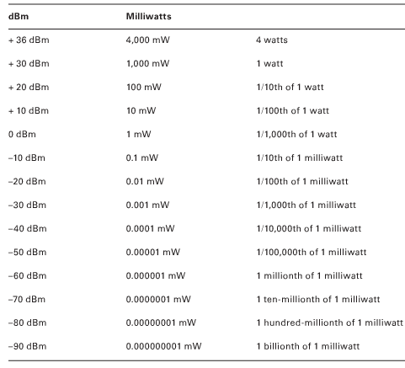
dBm & Milliwatt Conversions

Slide 33
Inverse Square Law
This law states that the change in power is equal to 1 divided by the square of the change in distance.
Or as the distance from the source of a signal doubles, the energy is spread out over four times the area, resulting in one-fourth of the original intensity of the signal.
The concept of free space path loss (FSPL) is based on Newton’s inverse square law.
The main variable for the inverse square law is simply distance.
The FSPL formula is also based on distance but adds another variable, which is frequency

Slide 34
RF Mathematics
You are about to learn RF math, without having to use logarithms.
If you know how to add and subtract using 3 and 10 and
If you know how to multiply and divide using 2 and 10,
You have all of the math skills you need to perform RF math
Here is how it goes --
Rule of 10s and 3s
The rule of 10s and 3s provides approximate values, not necessarily exact values.
If you are an engineer creating a product that must conform to RF regulatory guidelines, you will need to use logarithms to calculate the exact values.
If you are a network designer planning a network for your company, you will find that the rule of 10s and 3s will provide you with the numbers you need to properly plan your network.

Slide 35
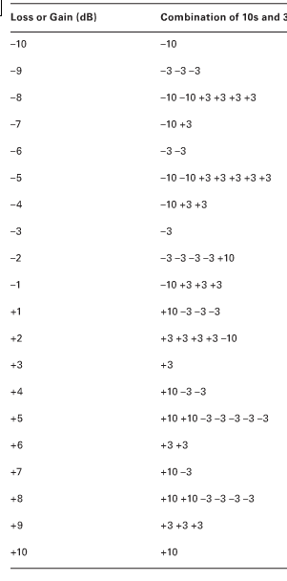
dB Loss and Gain (-10 thru +10)

Slide 36
Exercise
Hand-out on 10s & 3s

Slide 37
Received Signal Strength Indicator (RSSI)
Receive sensitivity refers to the power level of an RF signal required to be successfully received by the receiver radio.
The lower the power level that the receiver can successfully process, the better the receive sensitivity.
In WLAN equipment, receive sensitivity is usually defined as a function of network speed. Wi-Fi vendors will usually specify their receive sensitivity thresholds at various data rates,
Different speeds use different modulation techniques and encoding methods, and the higher data rates use encoding methods that are more susceptible to corruption.

Slide 38
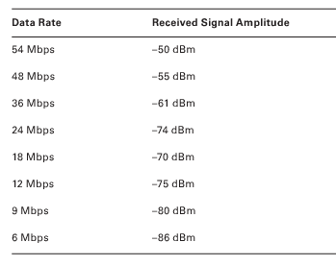
Receive Sensitivity Thresholds

Slide 39
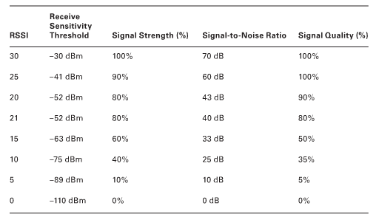
Received signal Strength indicator (RSSI) Metrics

Slide 40
Link Budget
When deploying radio communications, a link budget is the sum of all gains and losses from the transmitting radio, through the RF medium, to the receiver radio.
The purpose of link budget calculations is to guarantee that the final received signal amplitude is above the receiver sensitivity threshold of the receiver radio.
Link budget calculations include original transmit gain, passive antenna gain, and active gain from RF amplifiers.
All gain must be accounted for, including RF amplifiers and antennas, and all losses must be accounted for, including attenuators, FSPL, and insertion loss.
Any hardware device installed in a radio system adds a certain amount of signal attenuation called insertion loss.
Cabling is rated for dB loss per 100 feet, and connectors typically add about 0.5 dB of insertion loss.

Slide 41
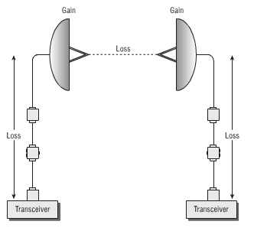
Link Budget Components

Slide 42
Fade Margin/System Operating Margin
Fade margin is a level of desired signal above what is required.
A good way to explain fade margin is to think of it as a comfort zone.
If a receiver has a receive sensitivity of –80 dBm, a transmission will be successful as long as the signal received is greater than –80 dBm.
The problem is that the signal being received fluctuates because of many outside influences such as interference and weather conditions.

Slide 43
Fade Margin/System Operating Margin
To accommodate for the fluctuation, it is a common practice to plan for a 10 dB to 25 dB buffer above the receive sensitivity threshold of a radio used in a bridge link.
The 10 dB to 25 dB buffer above the receive sensitivity threshold is the fade margin.
A fade margin of 10 dB is an absolute minimum.
This would only be acceptable for links less than 3 miles or so.
Up to 5 miles should have at least a 15 dB fade margin, and links greater than that should be higher.
A fade margin of 25 dB is recommended for links greater than 5 miles.

Slide 44
Exercise: Link Budget and Fade Margin
In this exercise, you will use a Microsoft Excel file to calculate a link budget and fade margin. You will need Excel installed on your computer.
From the CD that is included with this book, copy the file LinkBudget.xls to your desktop. Open the Excel file from your desktop.
In row 10, enter a link distance of 25 kilometers.
Note that the path loss due to a 25 kilometer link is now 128 dB in the 2.4 GHz frequency. In row 20, enter 128 for path loss in dB.
In row 23, change the radio receiver sensitivity to –80 dBm.
Notice that the final received signal is now –69 dBm, and the fade margin is only 11 dB.
Try to change the various components such as antenna gain and cable loss to ensure a fade margin of 20 dB.

Slide 45
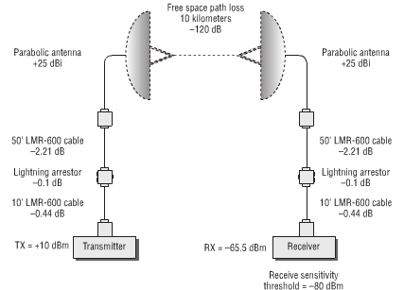
Point-to-Point link Budget Gain and Loss

Slide 46
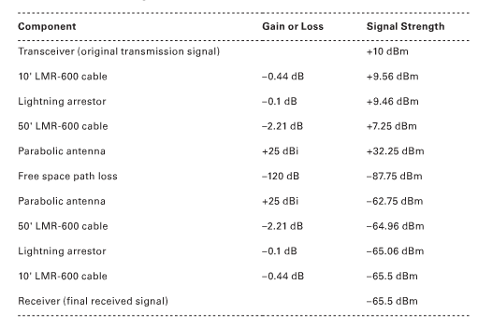
Link Budget Calculations

Slide 47
What Did I Learn?
We covered six key areas of RF communications:
RF components
RF measurements
RF mathematics
RSSI thresholds
Link budgets
Fade margins

Slide 48
What Did I Learn?
It is important to understand how each of the RF components affects the output of the transceiver.
Whenever a component is added, removed, or modified, the output of the RF communications is changed.
You need to understand these changes and make sure that the system conforms to regulatory standards.
The following RF components were key in this lesson:
Transmitter
Receiver
Antenna
Isotropic radiator
Intentional radiator (IR)
Equivalent isotropically radiated power (EIRP)

Slide 49
What Did I Learn?
In addition to understanding the components and their effects on the transmitted signal, you must know the different units of power and comparison that are used to measure the output and the changes to the RF communications:
Units of power
Watt
Milliwatt
dBm
Units of comparison
dB
dBi
dBd

Slide 50
What Did I Learn?
After you become familiar with the RF components and their effects on RF communications, and you know the different units of power and comparison, you need to understand how to perform the actual calculations and determine whether your RF communication will be successful.
It is important to know how to perform the calculations and some of the terms and concepts involved with making sure that the RF link will work properly.
These concepts and terms are as follows:
Rule of 10s and 3s
Receive sensitivity
Received signal strength indicator (RSSI)
Link budget
System operating margin (SOM)/fade margin

Slide 51
END
Ch 03 - Radio Frequency Components, Measurements, & Mathematics
Next
Ch 04 - Radio Frequency Signal and Antenna Concepts

